Slide 1
Tobacco House Bill. 3681
Michael Lewis
Miscellaneous Audit Manager
Field Operations

Slide 2
Agenda
SCDOR prior to H.3681
What is H.3681
New Definitions
New License/Notice
Civil Violations
Vending Machines
Resources

Slide 3
TAX STAMPS
48 STATES STAMP THEIR CIGARETTE PACKAGES
JANUARY 1, 2019 - SOUTH CAROLINA BECAME THE 48TH STATE TO REQUIRE CIGARETTE PACKAGES TO BE STAMPED
STATES THAT CURRENTLY DON’T STAMP CIGARETTES INCLUDE
NORTH CAROLINA
NORTH DAKOTA

Slide 4
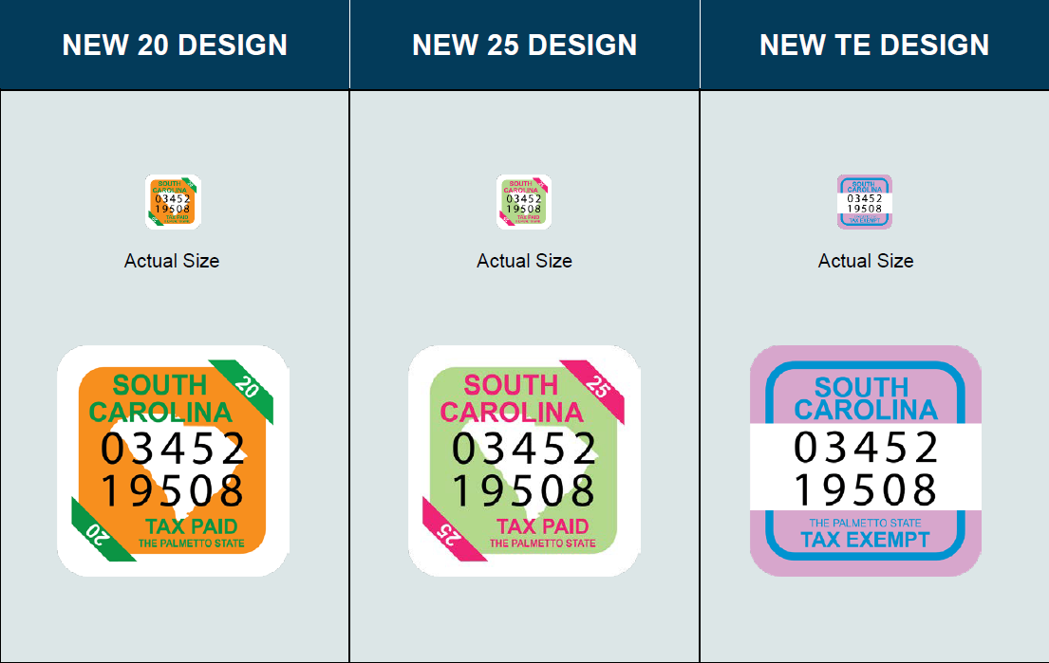
SOUTH CAROLINA FUSON® STAMP

Slide 5
MASTER SETTLEMENT AGREEMENT
MISSISSIPPI SUED THE MAJOR TOBACCO COMPANIES IN 1994 FOR:
MARKETING TO YOUTH
FRAUDULENT REPRESENTATIONS REGARDING HEALTH CONSEQUENCES
MANIPULATING NICOTINE CONTENT TO KEEP SMOKERS ADDICTED

Slide 6
MASTER SETTLEMENT AGREEMENT-MSA
46 STATES AND 4 US TERRITORIES HAVE JOINED LAWSUIT AND THE MASTER SETTLEMENT AGREEMENT WITH THE FOUR LARGEST TOBACCO MANUFACTURERS
PHILLIP MORRIS USA (ALTRIA SINCE 2003)
RJ REYNOLDS
BROWN & WILLIAMSON
LORRILARD
(40+ OTHER MANUFACTURERS HAVE JOINED INTO THE MSA)

Slide 7
MASTER SETTLEMENT AGREEMENT
SOUTH CAROLINA RECEIVES APPROXIMATELY $70 - 90 MILLION ANNUALLY FROM THE MASTER SETTLEMENT AGREEMENT-2022 $86.5 MILLION
THE 2020 MSA PAYMENT(BEFORE DISTRIBUTION BETWEEN THE STATES) WAS APPROXIMATELY $7.3 BILLION TO ALL MSA STATES (8.4 BILLION INCLUDING NON-MSA STATES)
SINCE 1998, SC HAS RECEIVED APPROX. 1.835 BILLION
SOUTH CAROLINA MUST SHOW DUE DELIGENCE TO RECEIVE MSA PAYMENT EACH YEAR

Slide 8
INSPECTIONS
TOBACCO TAX AUDITORS CONDUCT INSPECTIONS AT RETAIL LOCATIONS AND WHOLESALE DISTRIBUTORS
INSPECT PRODUCT AND INVOICES TO VERIFY SC TAXES HAVE BEEN PAID
INSPECT FOR OPEN PACKS AND OR SALE OF “LOOSIES” OR SINGLE CIGARETTES
INSPECT PRODUCT FOR OTHER STATES TAX STAMPS
INSPECT FOR CONTRABAND AND COUNTERFEIT PRODUCTS
INSPECT FOR DELISTED PRODUCT

Slide 9
VIOLATIONS
VIOLATION MAY BE ISSUED DURING RETAIL INSPECTIONS
RETAILERS ARE TO ONLY BUY CIGARETTES FROM SOUTH CAROLINA LICENSED DISTRIBUTORS
IF THEY FAIL TO SHOW THAT TAXES WERE PAID ON CIGARETTES THE PRODUCTS WILL BE SEIZED AND A $50 - $500 VIOLATION PER PACK WILL BE ISSUED
VIOLATIONS FOR SELLING “LOOSIE” OR SINGLE CIGARETTES ARE ALSO ISSUED WHEN OPEN PACKS OF CIGARETTES ARE FOUND OR IF THE AUDITOR WITNESSED THE SALE

Slide 10
H.3681
Required locations to notify The SCDOR if they sell tobacco products.
Locations would be held responsible for the actions of their employees
Locations could have their ability to sell tobacco products suspended
Changed who was responsible for underage compliance checks
SLED is responsible for the enforcement of the sections

Slide 11
Definitions SC Code Section 16-17-501
(3) "Electronic smoking device" means any device that may be used to deliver any aerosolized or vaporized substance, including e-liquid, to the person inhaling from the device including, but not limited to, an e-cigarette, e-cigar, e-pipe, vape pen, or e-hookah. "Electronic smoking device" includes any component, part, or accessory of the device, and also includes any substance intended to be aerosolized or vaporized during the use of the device whether or not the substance includes nicotine. "Electronic smoking device" does not include drugs, devices, or combination products authorized for sale by the U.S. Food and Drug Administration, as those terms are defined in the Federal Food, Drug, and Cosmetic Act.

Slide 12
Definitions SC Code Section 16-17-501
(4) "E-liquid" means a substance that:
(a) may or may not contain nicotine;
(b) is intended to be vaporized and inhaled using an electronic smoking device; and
(c) is a legal substance under the laws of this State and the laws of the United States.
"E-liquid" does not include cannabis or CBD as defined under the laws of this State and the laws of the United States unless it also contains nicotine.

Slide 13
Definitions SC Code Section 16-17-501
(8) "Tobacco product" means:
(a) any product containing, made of, or derived from tobacco or nicotine that is intended for human consumption or is likely to be consumed, whether inhaled, absorbed, or ingested by any other means including, but not limited to, a cigarette, a cigar, pipe tobacco, chewing tobacco, snuff, or snus;
(b) any electronic smoking device as defined in this section and any substances that may be aerosolized or vaporized by such device, whether or not the substance contains nicotine; or
(c) any component, part, or accessory of subitem (a) or subitem (b), whether or not any of these contains tobacco or nicotine including, but not limited to, filters, rolling papers, blunt or hemp wraps, and pipes. Tobacco product does not include drugs, devices, or combination products authorized for sale by the U.S. Food and Drug Administration, as those terms are defined in the Federal Food, Drug, and Cosmetic Act.

Slide 14
Definitions SC Code Section 16-17-501
(9) "Tobacco retail establishment" means any place of business where tobacco products are available for sale to the general public. The term includes, but is not limited to, grocery stores, tobacco product shops, kiosks, convenience stores, gasoline service stations, bars, and restaurants.
(10) "Tobacco retailer" means any person, partnership, joint venture, society, club, trustee, trust association, organization, or corporation who owns, operates, or manages any tobacco retail establishment. Tobacco retailer does not mean the nonmanagement employees of any tobacco retail establishment.

Slide 15
Notice of New License
12-36-511 states in part “For the purposes of this section, tobacco retailers and tobacco retail establishments that have a retail license must supplement their retail license application to notify the department that they sell or distribute tobacco or tobacco products. ”

Slide 16
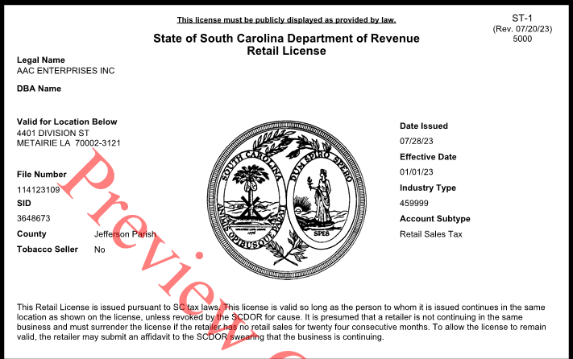
New Retail License

Slide 17
Civil Violations (A),(B),(C),(D)*, or (J)
Section 16-17-500. (A) It is unlawful for an individual to sell, furnish, give, distribute, purchase for, or provide a tobacco product to a minor under the age of eighteen years.
(B) It is unlawful to sell a tobacco product to an individual without a demand of proper proof of age. Failure to demand identification to verify an individual's age is not a defense to an action initiated pursuant to this subsection. Proof that is demanded, is shown, and reasonably is relied upon for the individual's proof of age is a defense to an action initiated pursuant to this subsection.

Slide 18
Civil Violations (A),(B),(C),(D)*, or (J)
(C) A person engaged in the sale of tobacco products made through the Internet or other remote sales methods shall perform an age verification through an independent, third-party age verification service that compares information available from public records to the personal information entered by the individual during the ordering process that establishes the individual is eighteen years of age or older and shall use a method of mailing, shipping, or delivery that requires the signature of a person at least eighteen years of age before a tobacco product will be released to the purchaser, unless the Internet or other remote sales methods employ the following protections to ensure age verification:
(1) the customer creates an online profile or account with personal information including, but not limited to, name, address, social security information, and a valid phone number, and that personal information is verified through publicly available records; or
(2) the customer is required to upload a copy of his government-issued identification in addition to a current photograph of the customer; and
(3) delivery is made to the customer's name and address.

Slide 19
Civil Violations (A),(B),(C),(D)*, or (J)
(J)(1) A tobacco retail establishment that has as its primary purpose the sale of tobacco products must prohibit minors under the age of eighteen years from entering the tobacco retail establishment, unless the minor is actively supervised and accompanied by an adult, and shall determine whether a person is at least eighteen years of age by requiring proper proof of age in accordance with subsection (B), prior to the sale of a tobacco product.
(2) A tobacco retail establishment described in item (1) must conspicuously post on all entrances to the establishment the following:
(a) a sign in boldface type that states "NOTICE: It is unlawful for a person under eighteen years of age to enter this store, unless the minor is actively supervised and accompanied by an adult. Age will be verified prior to sale.";
(b) a sign printed in letters and numbers at least one-half inch high that displays a toll free number for assistance to callers in quitting smoking, as determined by the Department of Health and Environmental Control.

Slide 20
Civil Violations 16-17-500(E)(3)
(3) A tobacco retailer who knowingly violates or permits an employee to violate a provision of subsections (A), (B), (C), (D), or (J) in the tobacco retail establishment is subject to an administrative penalty as follows:
(a) for a first violation, issued a warning;
(b) for a second violation within a thirty-six-month period, fined not less than three hundred dollars;
(c) for a third violation within a thirty-six-month period, fined not less than six hundred dollars;
(d) for a fourth and subsequent violation within a thirty-six-month period, fined not less than one thousand two hundred dollars and the tobacco retailer is prohibited from selling or distributing tobacco products for a period of at least seven days and no greater than thirty days. For purposes of this subsection, a tobacco retailer that knowingly sells or distributes during the period that the tobacco retailer is prohibited from selling or distributing is subject to a fine of not more than two hundred dollars and is prohibited from selling or distributing tobacco products for an additional period of seven days; and

Slide 21
Civil Violations (referencing licensing)
12-36-511
For the purposes of this section, a retailer that sells tobacco, tobacco products, or any other product used for smoking that does not disclose on their initial retail application or supplement their retail license application is subject to a fine of not more than two hundred dollars and must file within fifteen days of notification of a failure to file. A retailer that fails to file within fifteen days after the notification is subject to a fine of two thousand dollars.

Slide 22
E-liquid containers
SECTION 10. Section 16-17-506 of the S.C. Code is amended to read:
Section 16-17-506. (A) For purposes of this section, "container" means a bottle or other container of any kind that contains e-liquid and is offered for sale, sold, or otherwise distributed, or intended for distribution to consumers, but that does not include a cartridge that is prefilled and sealed by the manufacturer and not intended to be opened by the customer.
(B) It is unlawful to sell, hold for sale, or distribute a container of e-liquid unless:
(1) the container satisfies the requirements of 21 C.F.R. 1143.3, if applicable, for the placement of labels, warnings, or any other information upon a package of e-liquid that is to be sold within the United States;
(2) the container complies with child-resistant effectiveness standards under 16 C.F.R. 1700.15(b)(1) when tested in accordance with the requirements of 16 C.F.R. 1700.20; and
(3) the container complies with federal trademark or copyright laws.

Slide 23
E-liquid containers
(C) A person who knowingly sells, holds for sale, or distributes e-liquid containers in violation of subsection (B) is guilty of a misdemeanor and, upon conviction, must be imprisoned for not more than three years or fined not more than one thousand dollars, or both.
(D) In addition to the other penalties provided by law, law enforcement may seize and destroy or sell to the manufacturer, for export only, any containers in violation of this section.
(E) Any tobacco retailer or tobacco retail establishment that permits an employee to violate or knowingly violates subsection (B) is subject to the penalties in Section 16-17-500(E)(3).

Slide 24
Vending Machines
SC Code Section 16-17-500(D) It is unlawful to sell a tobacco product through a vending machine.
However on August 11, 2023 the Attorney General’s Offices issued an opinion that this was not the intent of the statute.

Slide 25
Resources MYDORWAY

Slide 26
Resources MYDORWAY

Slide 27
Resources MYDORWAY

Slide 28
Resources MYDORWAY

Slide 29
Michael Lewis
Miscellaneous Audit Manager
803-898-5771
Michael.Lewis@dor.sc.gov

Slide 30
SLED CONTACTS:
Midlands-
Lt. Ben Ross 803.960.9297
Piedmont –
Lt. Keith Dorman 803.608.5211
Pee Dee –
Lt. Chad Mullinix 803.920.2016
Low Country –
Lt. David Leslie 803.608.3204
STATE CONTACTS
DOR:
Greenville-
Michael Gilstrap-Supervisor
864-552-4919
Michael.Gilstrap@dor.sc.gov
Columbia-
Tyrone Donaldson
803-898-5192
Tyrone.Donaldson@dor.sc.gov
Josh Cruea
803-898-5693
Josh.Cruea@dor.sc.gov
Charleston-
Matthew Group
843-953-8374
Matthew.Group@dor.sc.gov
Myrtle Beach-
Cory Johnson
843-492-2020

